Slide 1
Elements of a Short Story
ENG 10

Slide 2
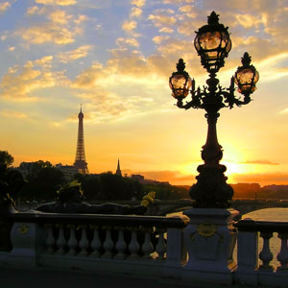
Setting
Physical background of a story – where and when the story takes place .
Place | Geographic location
Time | Historical period

Slide 3
Atmosphere
This element has a close connection to the setting because it often determines the atmosphere.
The atmosphere is the mood or tone of the story.
Atmosphere is usually established at the beginning of the story. It takes in characters, clothing, furniture, natural surroundings, light, darkness, shadows, even weather.

Slide 4
Plot
The plot is how the author arranges events to
develop their story; it is the sequence of
events in a story or play.
The plot has a clear beginning, middle, and
end. A short story usually has a single plot, so
it can be read in one sitting.

Slide 5
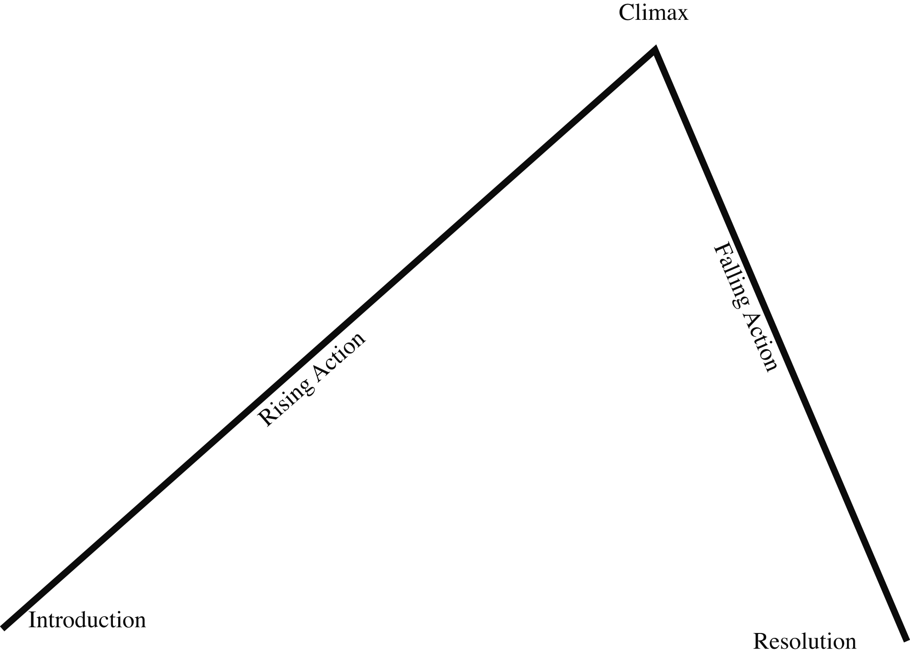
Plot Graph
Rising Action - This is where the events in the story become complicated and the conflict in the story is revealed.
Climax - This is the highest point of interest and the turning point of the story.
Falling action - The events and complications begin to resolve themselves.
Exposition- The beginning of the story where the characters and the setting is revealed.
Resolution- This is the final outcome or untangling of events in the story.

Slide 6
Characters
The plot can only exist with character(s). The main character is placed in a situation that contains a problem he must overcome; therefore, conflict exists.
One character is clearly central to the story with
all major events having some importance to this
character - he/she is the PROTAGONIST.
The character in opposition to the main
character is called the ANTAGONIST.

Slide 7
Characters
We learn about a character by using the STEAL method:
S. what he/she Says
T. what he/she Thinks
E. what Effect the character has on the other characters (what others say about him/her and how others react to him/her)
A. how the character Acts (things they do or do not do)
L. how the character Looks
*Also consider: an author's direct statement

Slide 8
Types of Characters
Flat Character - character who doesn't go through a change. These characters are usually one-dimensional.
Round (Dynamic) - character is affected by the events of the story. These characters are usually fully developed in terms of personality. They are described in more detail and usually learn and grow by the end of the story.
Stereotyped Characters - a character that is so well known that little has to be said about him/her. These characters are immediately recognizable because of the role he/she plays.

Slide 9
Conflict
External - Character struggles with an outside force
Internal - A struggle within a character
There are FIVE kinds of conflict:
Person vs Person
Person vs Self
Person vs Society
Person vs Nature
Person vs Circumstance

Slide 10
Theme
The theme is essentially the main idea behind
the story. It may be the author's thoughts
about a topic or the message they want to
deliver to their audience. The title of the
short story sometimes helps us to understand
what they are trying to tell us.
Examples: The corrupting power of ambition Don’t judge a book by its cover
Love is blind Guilt will haunt you

Slide 11
Foreshadowing
Foreshadowing is when a story provides hints as to what will happen in the future.

Slide 12
Diction – Word choice
Word choice can be formal, informal, colloquial or slang.
Formal is usually found in academic texts, academic papers and formal discourse.
Informal is relaxed conversation and is found in writing that has a lighter tone and is sometimes humorous.

Slide 13
Point of View
The vantage point from which the author presents the action of the story.
The point of view identifies the person telling the story. Most often, you’ll meet three kinds of point of view in stories and novels.
First person
Third person limited
Third person omniscient

Slide 14
Handout for Perspective
Point of View note

Slide 15
Use of Irony
Irony refers to some sort of discrepancy between what is expected and what actually happens.

Slide 16
Verbal Irony
The use of words to convey a meaning that is the opposite of its literal meaning.
Example:
Jonanthan Swift calls his solution to Ireland’s problem a “Modest Proposal” even though he suggests eating the children of the poor. Ew!

Slide 17
Situational Irony
Opposite of what we expect to happen
actually occurs.
EXAMPLE:
Michael Moore uses the song “It’s a Wonderful World” in his documentary while showing pictures of war.

Slide 18
Dramatic Irony
When the audience knows more than the characters in the story. Adds “drama”
EXAMPLE:
We know from the prologue of R&J that they will die; however, the other characters do not.

