Slide 1
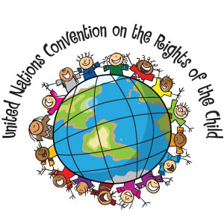

Slide 2
The Convention:
A human rights treaty which sets out the civil, political, economic, social, health and cultural rights of children.
Defines a child as any human being under the age of eighteen
Nations that ratify this convention are bound to it by international law.
Compliance is monitored by the UN Committee on the Rights of the Child, which is composed of members from countries around the world.
The committee is required to submit a progress report once a year.

Slide 3
Governments of countries that have ratified the Convention are required to report to, and appear before, the United Nations Committee on the Rights of the Child periodically to be examined on their progress with regards to the advancement of the implementation of the Convention and the status of child rights in their country.
Currently, 196 countries are party to it, including every member of the United Nations except the United States.
The US has signed but not ratified the convention
Ratify: sign or give formal consent to (a treaty, contract, or agreement), making it officially valid.

Slide 4
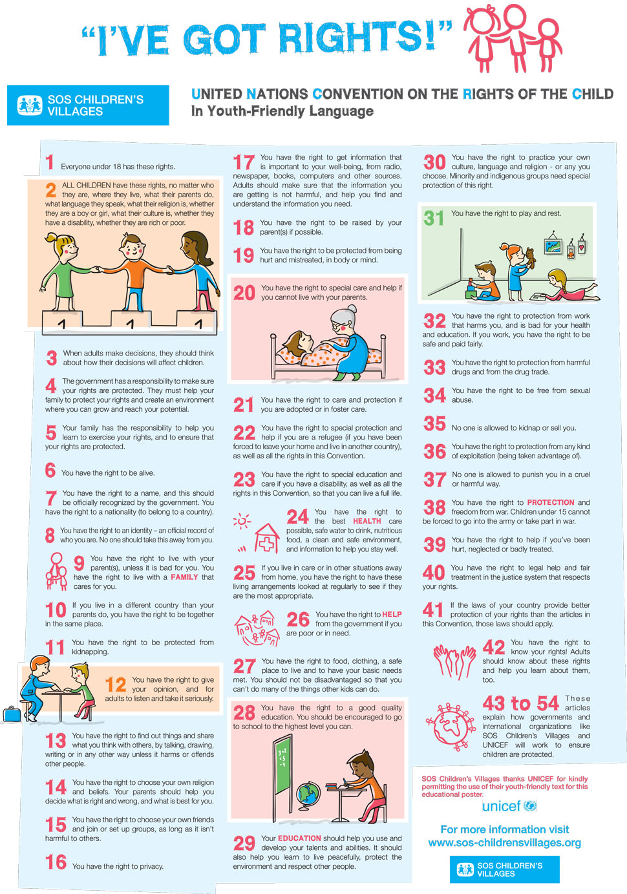

Slide 5
Task:
With your partner, cut out your 15 rights, and glue them to your diamond grid in order of importance based on your discussion about each.
Find another group of two and discuss your diamond grids. How do they compare to one another?
Now, cut out the 15 rights again, and create a new diamond grid, negotiating with your group the order of importance for each.

Slide 6
Reflection Questions:
What was your most important right? Why?
What was your least important right? Why?
What things did you change when you grouped up? Explain how that process of negotiating and compromise went.
What did you learn today about the Conventions of the Rights of a Child?

