Slide 1
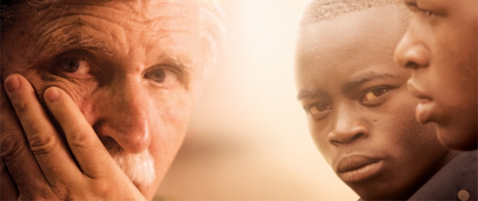
Fight Like Soldiers, Die Like Children
A Documentary by Lt. General Roméo Dallaire

Slide 2
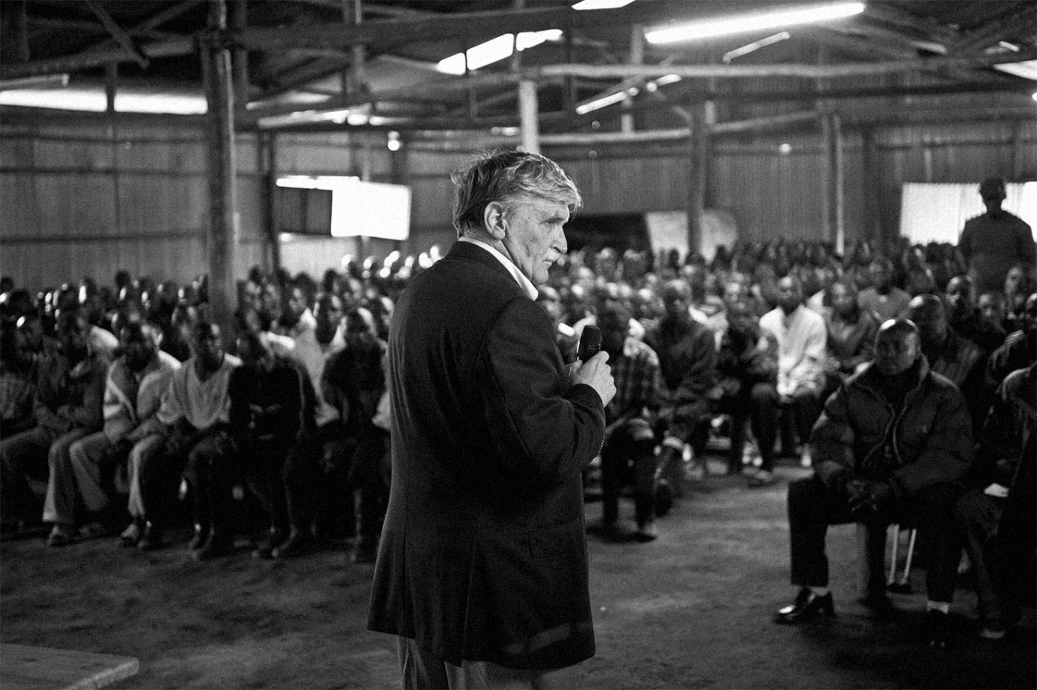
Lt. General Romeo Dallaire
“Now is the time to take up the cause of the advancement of human rights for all and the moment is yours to grasp.”

Slide 3
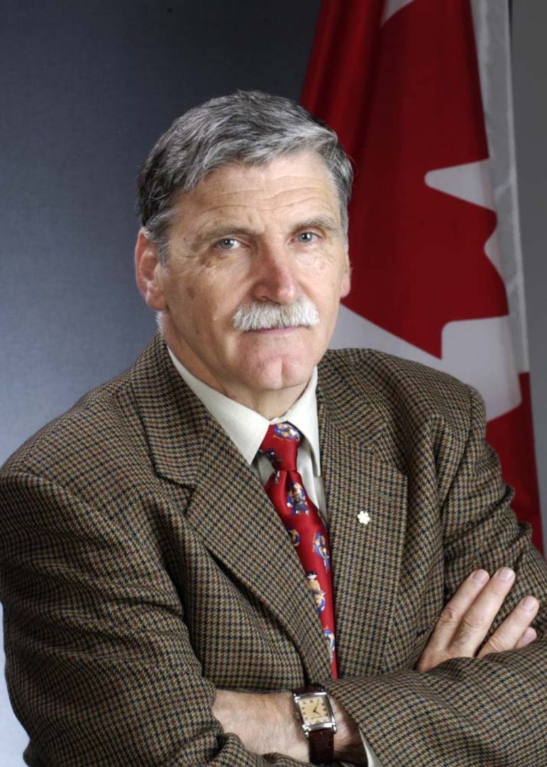
Canadian Peacekeeper and…
Roméo Dallaire was a Canadian Senator (March 24, 2005 - June 17, 2014 and a member of the Liberal Party of Canada) and retired Canadian Army Lieutenant-General.

Slide 4
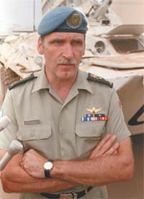
Dallaire’s Career
Throughout his distinguished military career, LGenDallaire served in staff, training, and command positions throughout North America, Europe, and Africa; rising in rank from Army Cadet in 1960 to Lieutenant-General in 1998.

Slide 5
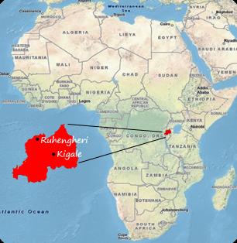
Dallaire in Rwanda
LGenDallaire was appointed Force Commander of the United Nations Assistance Mission in Rwanda (UNAMIR) prior to and during the 1994 genocide.
LGenDallaire provided the United Nations with information about the planned massacre, which ultimately took more than 800,000 lives in less than 100 days.
Permission to intervene was denied and the UN withdrew its peacekeeping forces.
LGenDallaire, along with a small contingent of Ghanaian soldiers and military observers, disobeyed the command to withdraw and remained in Rwanda to fulfill their ethical obligation to protect those who sought refuge with the UN forces.

Slide 6
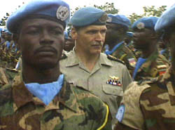
Dallaire’s Recognition
As a result of his work, he has earned the Meritorious Service Cross, the United States Legion of Merit, the Aegis Award on Genocide Prevention, and the affection and admiration of people around the globe.

Slide 7
Hotel Rwanda
The popular Hollywood movie starring Don Cheadle and Nick Nolte depicts the Rwandan genocide.
Dallaire has been critical of the film, but says at least it gives attention to the tragedies in Rwanda.

Slide 8
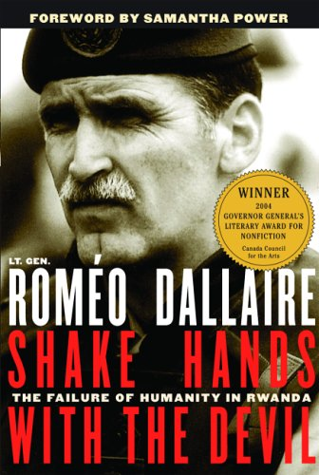
Dallaire’s Writings
Shake Hands with the Devil – the Failure of Humanity
in Rwanda(won the Governor General’s Literary Award
for Non-Fiction in 2004, and many other accolades).
And was turned into a full-length feature film.
Dallaire’s most recent book, They Fight Like Soldiers; They Die Like Children – the Global Quest to Eradicate the Use of Child Soldiers, introduces the Child Soldier phenomenon and solutions to eradicate it (to which LGenDallaire has committed the rest of his life).

Slide 9
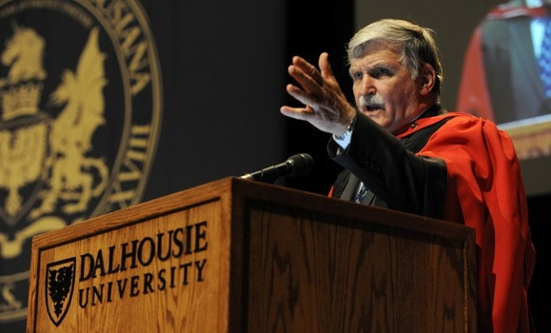
His Work Continues
Dallaire is President of the Lieutenant-General RoméoDallaire Foundation; founder of the Child Soldiers Initiative, an outspoken advocate for human rights – particularly:
War-Affected Children,
Women,
the Canadian First Nations,
and Military Veterans.

Slide 10
Where is Dallaire Now?
At age 70, he continues to fight for his cause.
Dallaire said his mission to understand and change the plight of child soldiers helped pull him out of the emotional chaos that overwhelmed him after his tragic and failed peacekeeping mission in Rwanda in 1993 and 1994.
The opportunity to speak about war-affected children has given him a reason to live, and something worth fighting for.

Slide 11
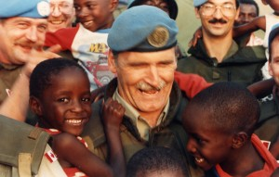
How Can We Help?
Dallaire said he feels a sense of optimism when he looks at the generation of kids in schools these days. “They have no sense of ‘the other.’ Through the Web the youth have become aware of the world, they are not afraid of multi-ethnicity, human rights, they can grasp grand concepts.”
He believes that if kids across Canada — at an elementary or high school level, and at the university level — mobilized through social networks, they could make direct connections with youth in conflict zones.

Slide 12
Dallaire still seethes with rage at the helplessness he felt two decades ago when he saw child soldiers in action in Rwanda, “the living souls … who have been influenced to commit such horrific acts … and the adults that directed them.”
“Go and get your boots dirty,” he said. “Be part of the solution.”
“Why are those kids not as human as us?” he asked. “If they are as human as us, then why aren’t we intervening?”
Dallaire hopes his new book will reach young people and that they, in turn, will reach out “to help their peers in these countries.”

Slide 13
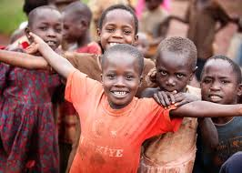
In Our Backyard!
The Roméo Dallaire Child Soldiers Initiative (the Dallaire Initiative) is a global partnership based at Dalhousie University.
Our mission is to progressively eradicate the use and recruitment of child soldiers through a security sector approach.
Our vision is a world where children are no longer recruited or used as weapons of war.

Slide 14
While Watching the Documentary:
Take notes on the documentary as you watch. You will use these notes as evidence for your persuasive essay.
Think about the problems that come with using child soldiers:
To the child (mentally, emotionally, physically)
To the community (fear, suspicion, breakdown of tradition)
To the world (UN soldier missions, how LGenDallaire describes the impact on his mental state, non-profit groups committed to getting children out of this situation, impact on the rest of the world)

